Slide 1

Beautiful Waste
Presented by Md. Monir Ahammod 16CSE061 Department of Computer Science and Engineering BSMRSTU |  | Supervised by Md. Nesarul Hoque Assistant Professor, Department of Computer Science and Engineering BSMRSTU
Computer Science and Engineering

Slide 2
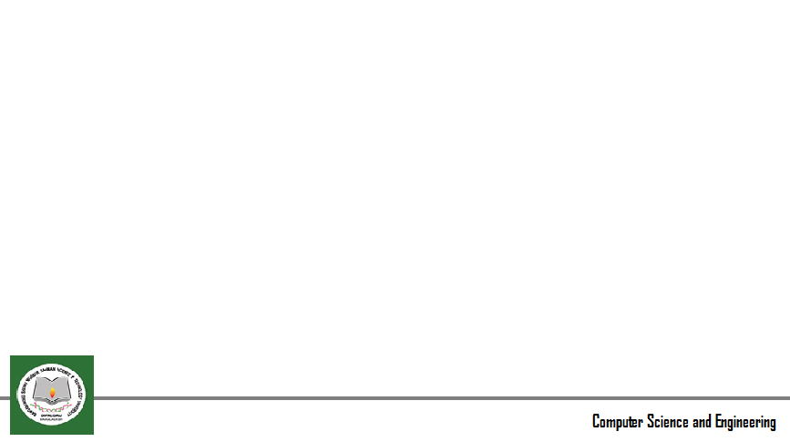
Contents
Introduction
Motivation
Objectives
Related Works and Limitations
Methodology
Implementation
Conclusion & Future Scopes

Slide 3
Introduction
Beautiful Waste is an e-commerce website based on “Laravel” framework.
Wastage materials are harmful to our environment.
Nowadays online e-commerce business is very popular.
We can make some beautiful handicrafts from these wastage materials.
In this project, we need a few investments.
So a person or a small organization can run this type of business easily.

Slide 4
Motivation
My website is an e-commerce website containing handicraft products.
Handicraft is the old heritage of our country.
Environmental pollution is a big problem in our country.
Some wastage materials are not rotting like plastic bottles.
By using wastage materials, we do not need a lot of money.

Slide 5
Objectives
There are some goals for making this website.
Build an e-commerce website dedicated to unemployed people or a small organization.
Making the process of buying handicraft products online.
Using wastage materials environmental pollution can be solved.

Slide 6
Previous Works and Limitations
There is some similar type of applications in the world.
In Bangladesh, there are very few websites.
Examples: “BAGDOOM” and “Desi Crafts” .
They use very few wastage materials which are not enough.

Slide 7
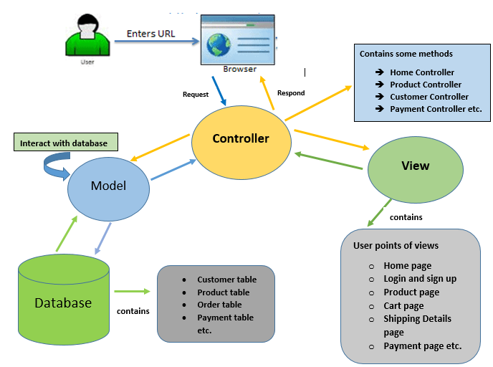
Methodology
Flow chart

Slide 8
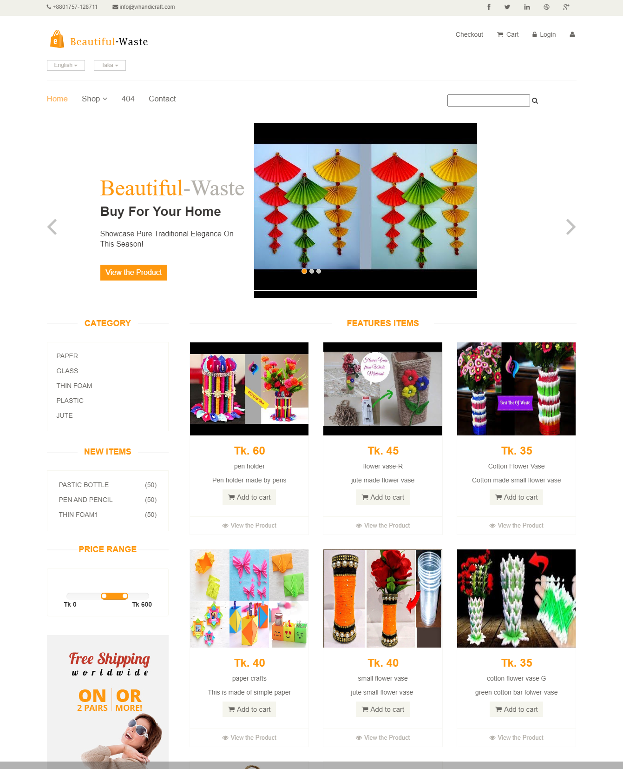
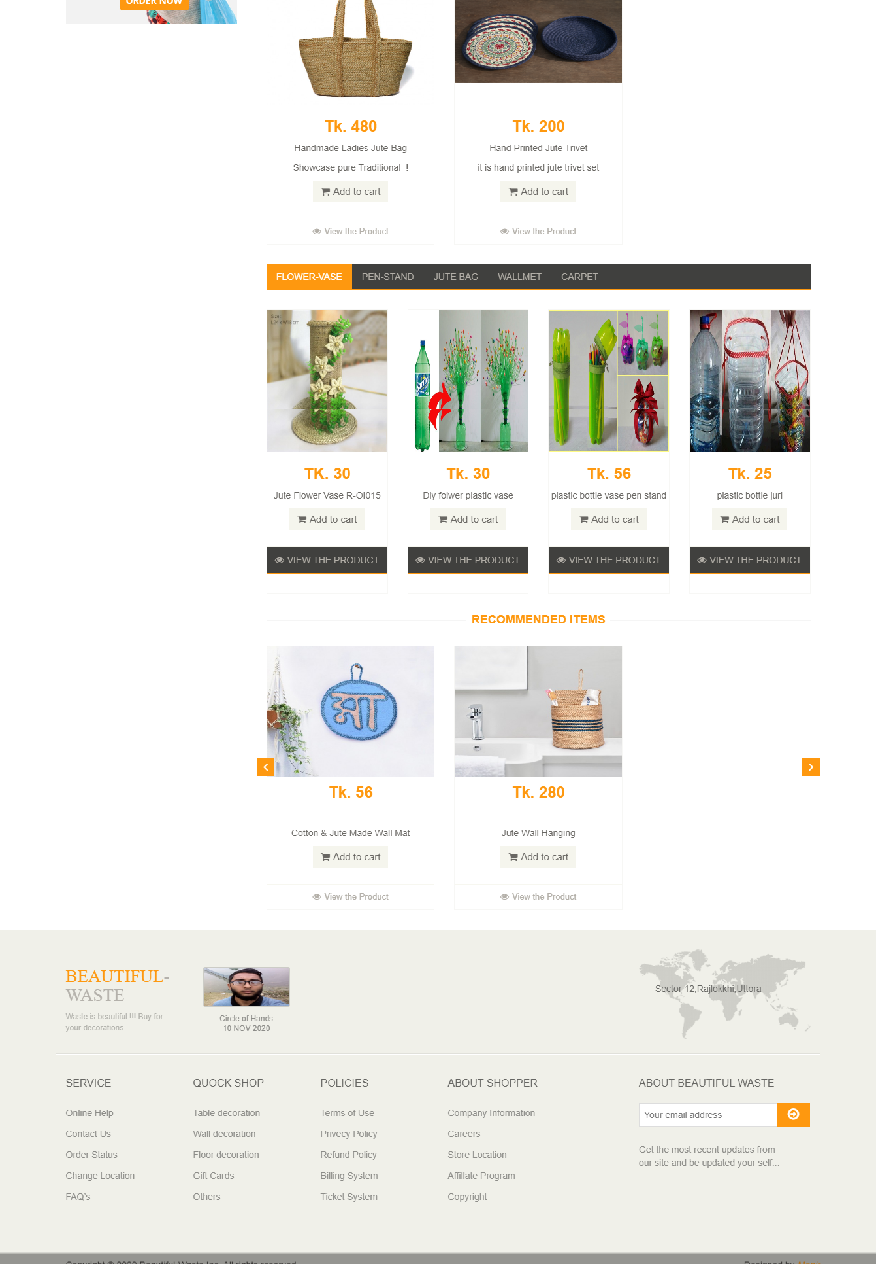
Implementation Details
Flow chart
Figure : Home Page I
Figure : Home Page II

Slide 9
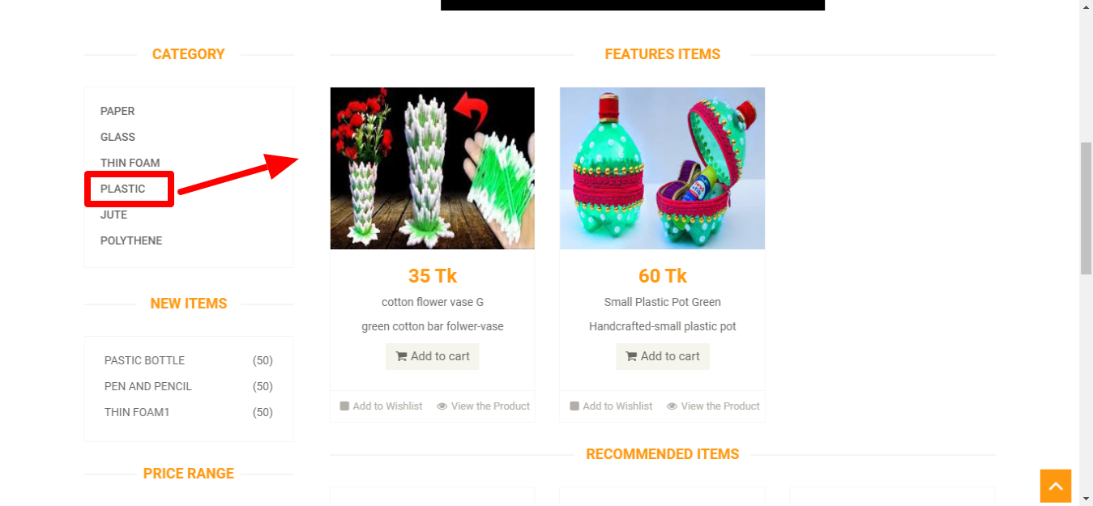
Category wise Product
Flow chart
Figure : Category wise Product

Slide 10
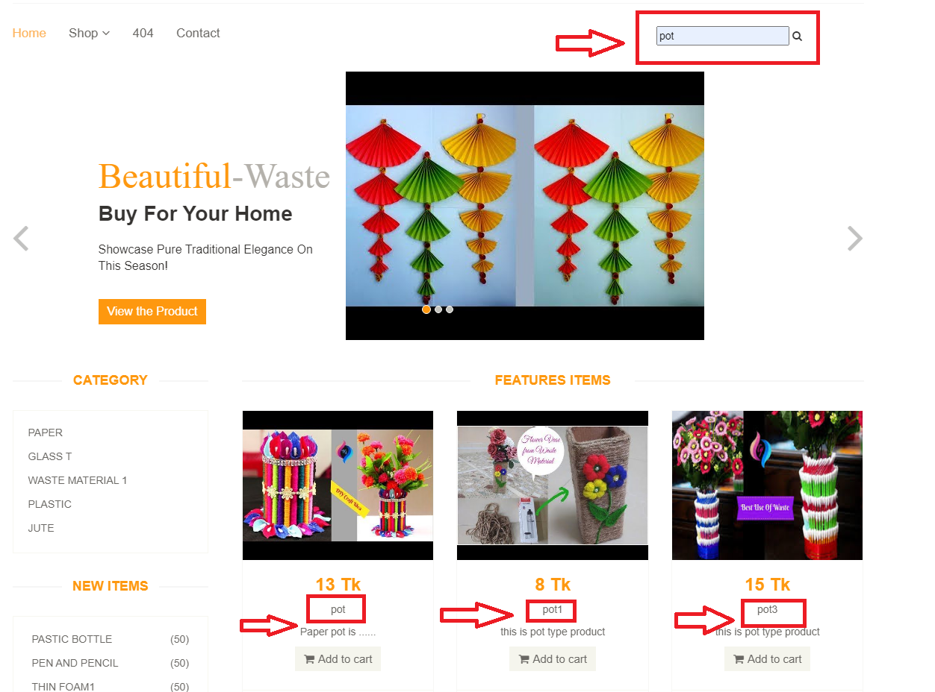
Search Product
Flow chart
Figure : Search Product

Slide 11
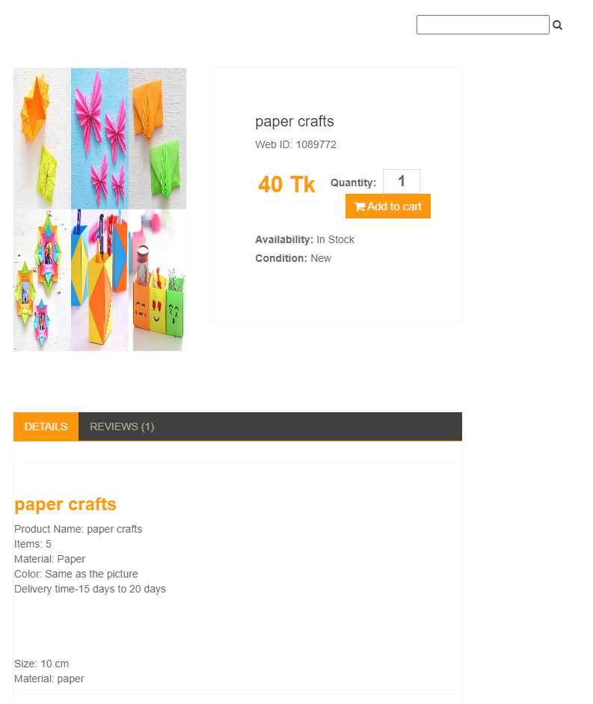
Product View & Details
Flow chart
Figure : Product View page

Slide 12
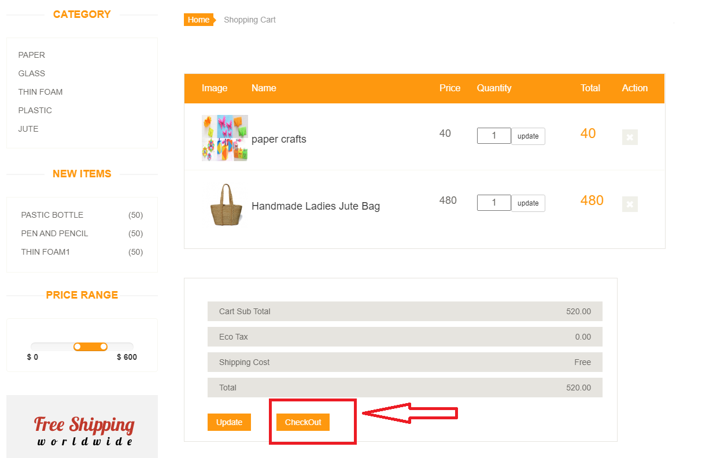
Cart Page
Flow chart
Figure Shopping Cart page

Slide 13
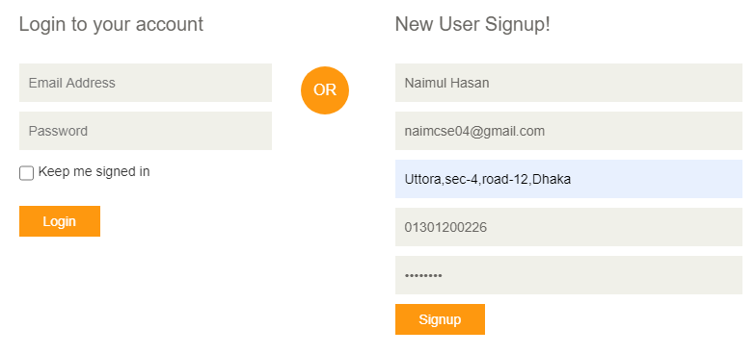
Login & Signup page
Flow chart
Figure : Login and Signup page

Slide 14
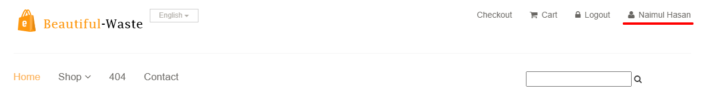
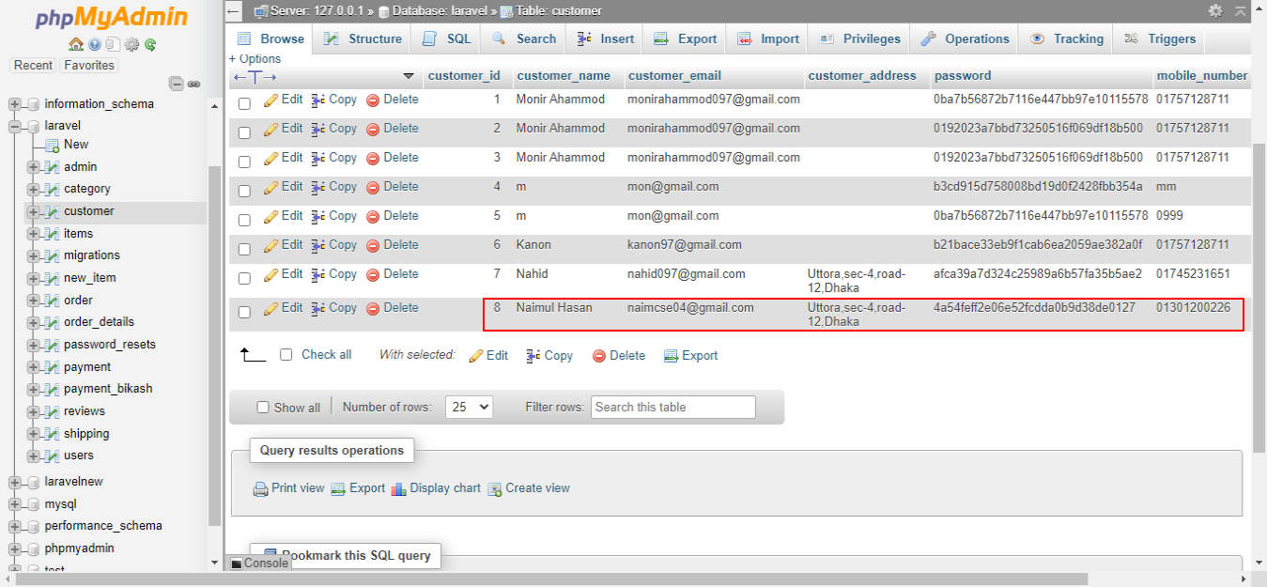
Customer Details
Flow chart
Figure : Customer details in database

Slide 15
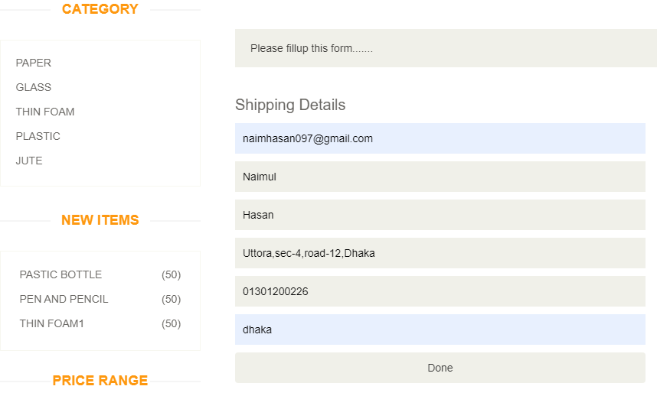
Shipping Details
Flow chart
Figure : Shipping Details page

Slide 16
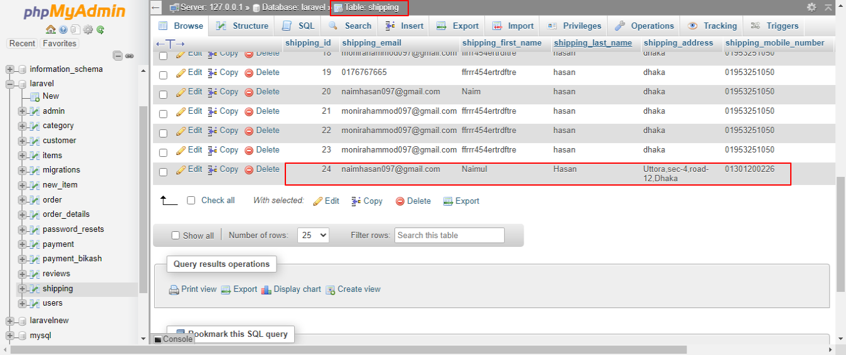
Shipping Details (Cont.)
Flow chart
Figure : Shipping details in database

Slide 17
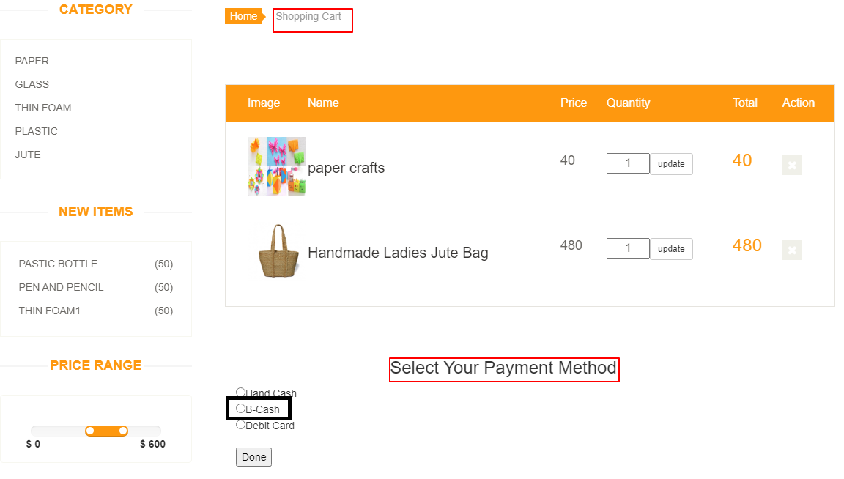
Payment Method
Flow chart
Figure : Payment method page

Slide 18
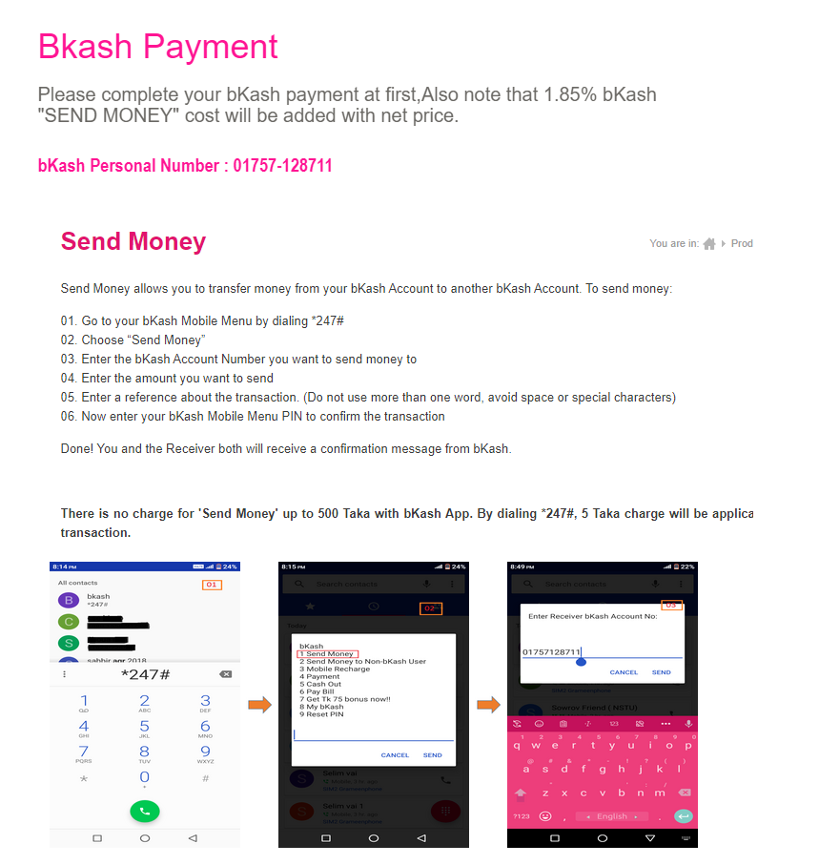
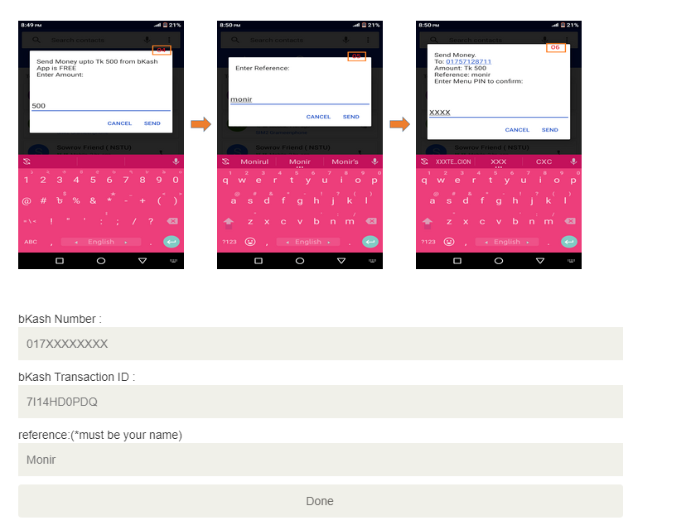
BKash Payment
Flow chart
Figure : BKash Payment page I
Figure : BKash Payment page II

Slide 19
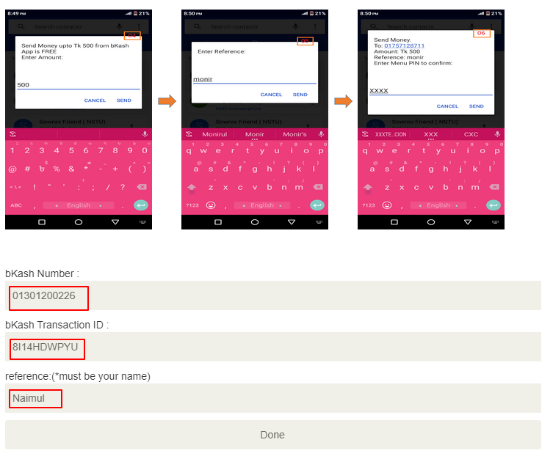
BKash Payment (Cont.)
Flow chart
Figure : BKash payment form Page

Slide 20
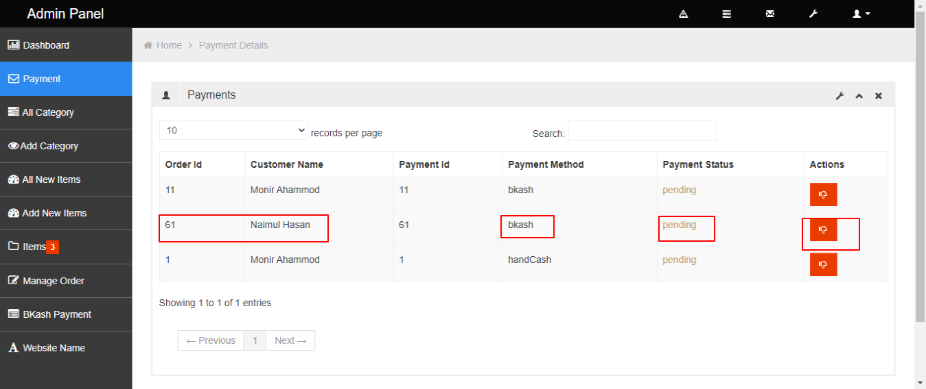
BKash Payment (Cont.)
Flow chart
Figure : BKash payment details in admin panel

Slide 21
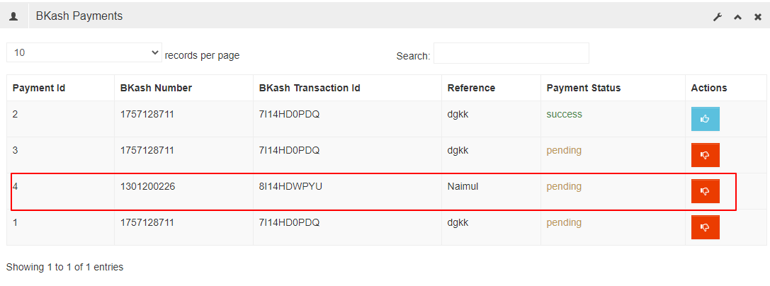
BKash Payment (Cont.)
Flow chart
Figure : BKash payment complete details

Slide 22
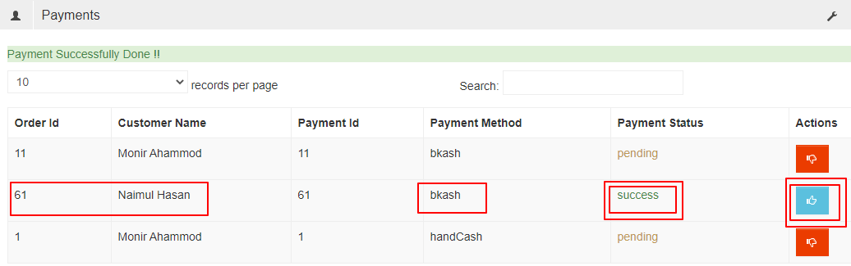
Order Complete
Flow chart
Figure : BKash Order complete Page

Slide 23
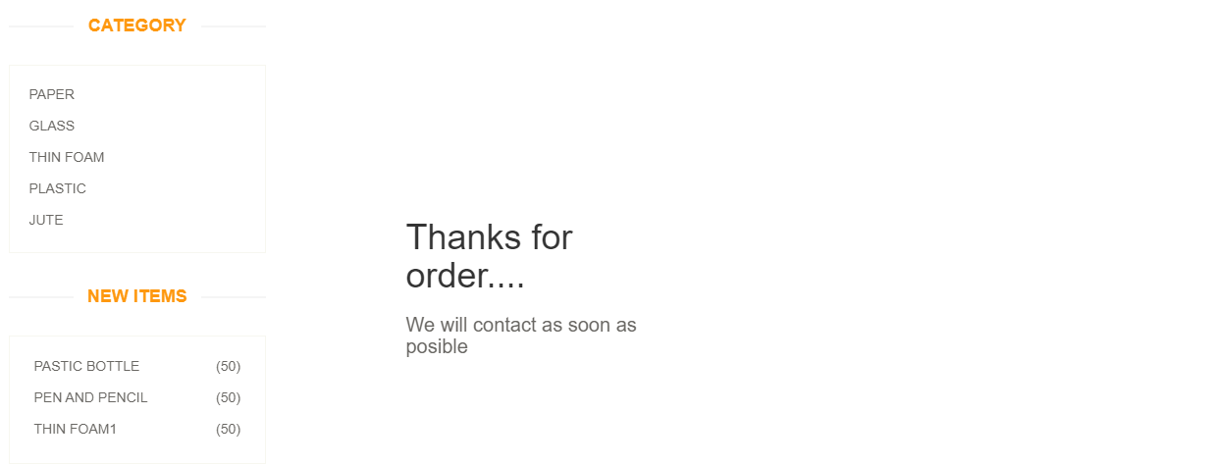
Confirmation Page
Flow chart
Figure : Confirmation Page

Slide 24
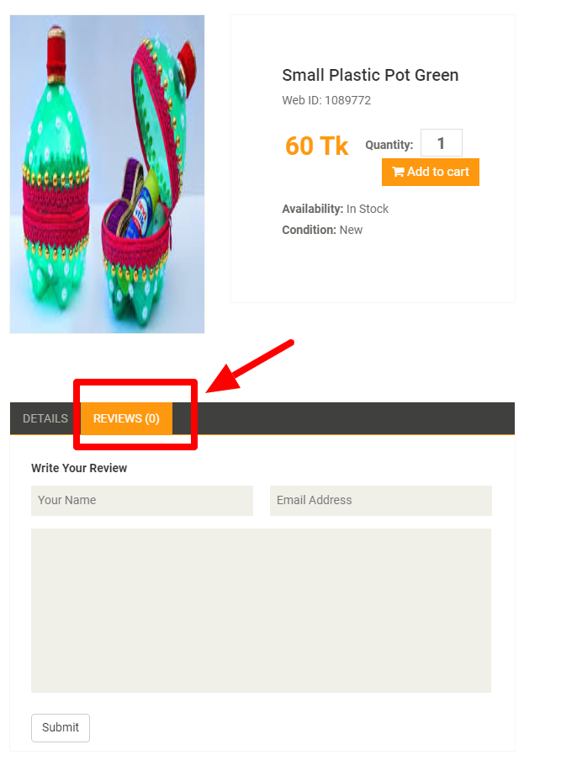
Product Review
Flow chart
Figure : Product review Page

Slide 25
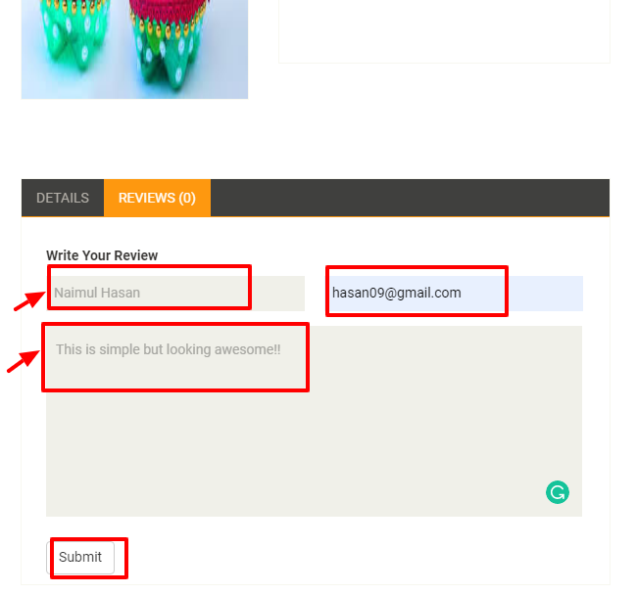
Product Review (Cont.)
Flow chart
Figure : Review form

Slide 26
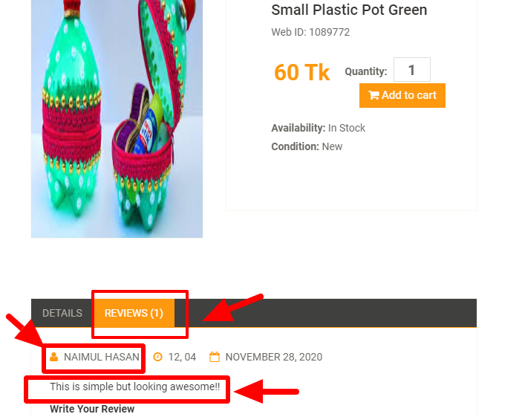
Product Review (Cont.)
Flow chart
Figure : Review Page

Slide 27
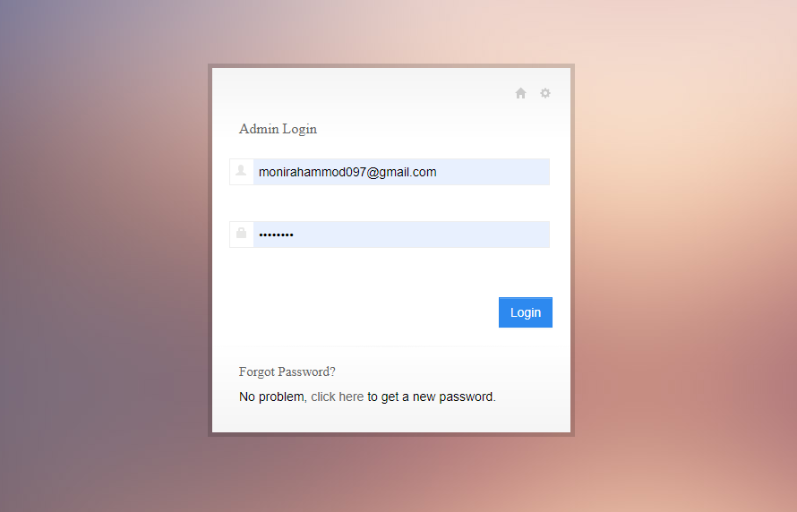
Admin Login
Flow chart
Figure : Admin Login

Slide 28
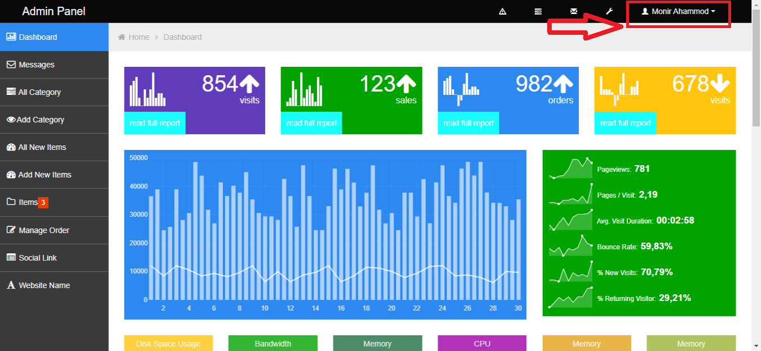
Admin Panel
Flow chart
Figure : Admin Panel

Slide 29
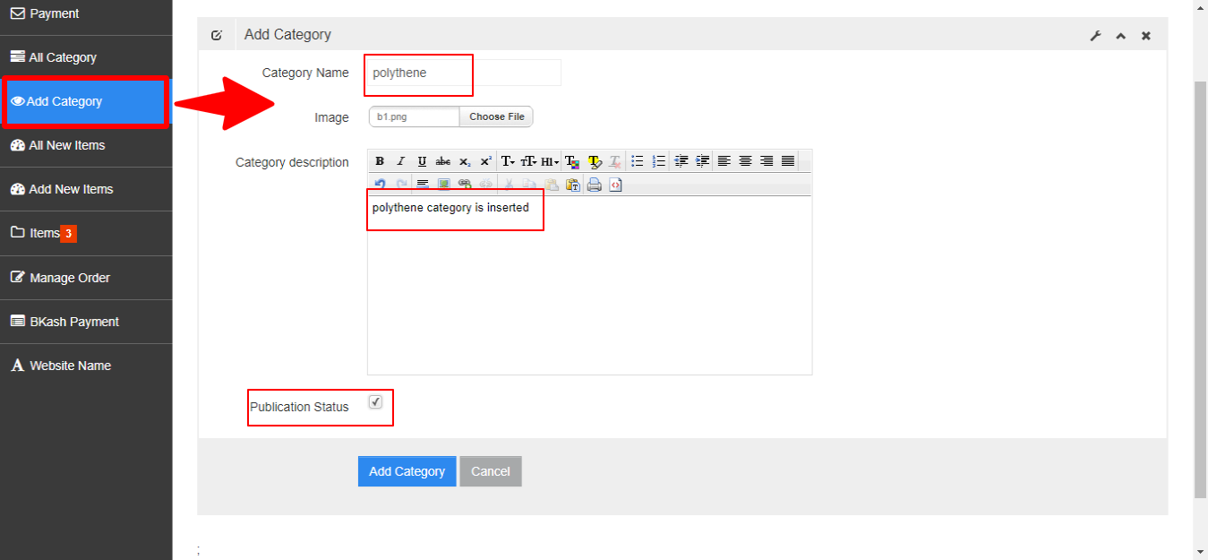
Add a Category
Flow chart
Figure : Add a Category

Slide 30
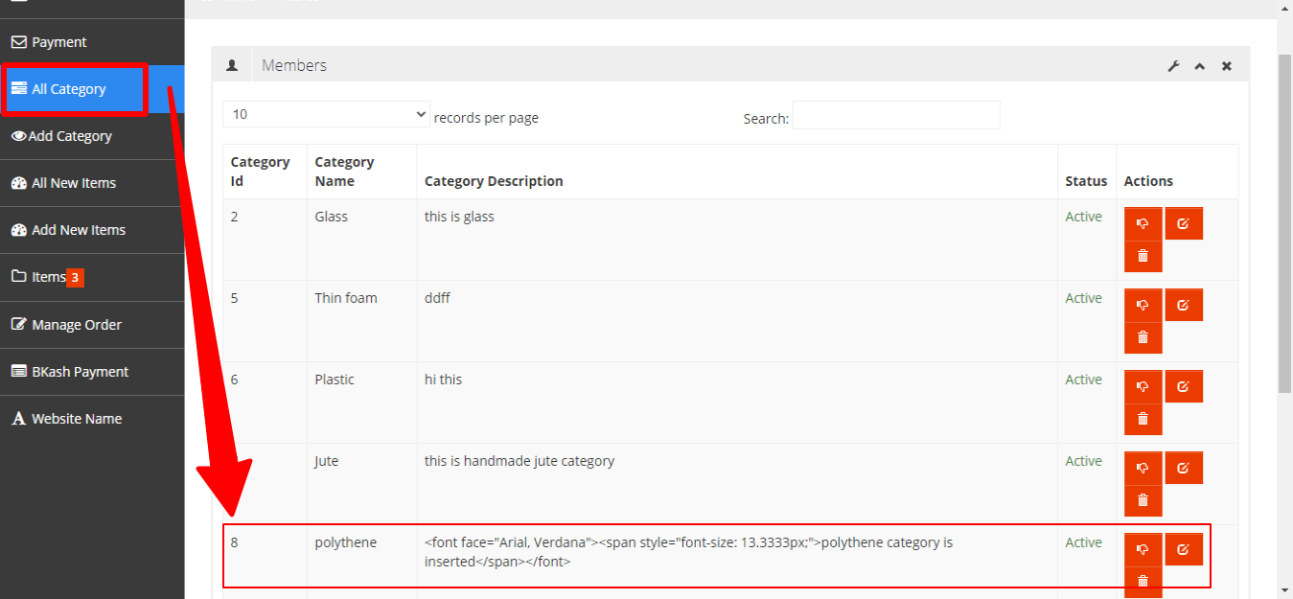
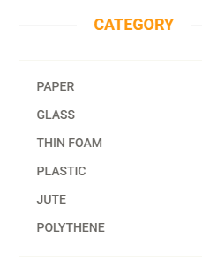
Add a Category (Cont.)
Flow chart
Figure : Add a Category

Slide 31
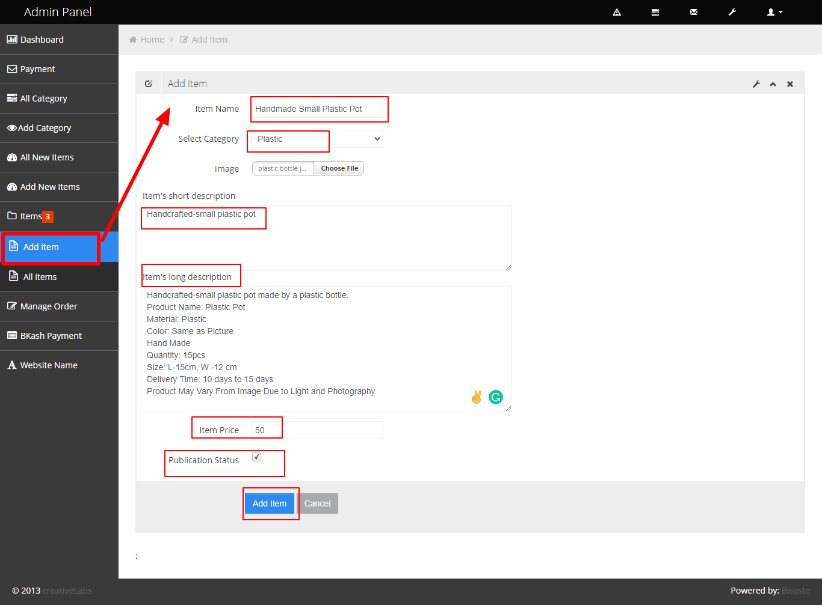
Add New Product
Flow chart
Figure : Add Product

Slide 32
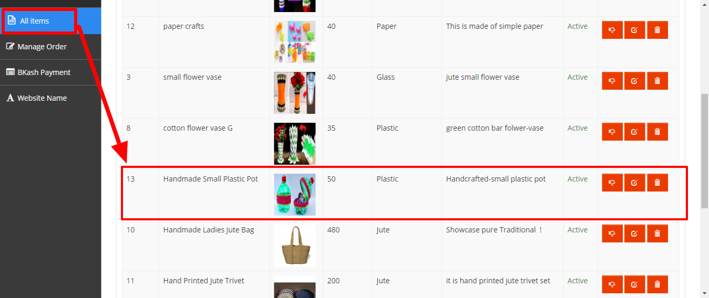
Add New Product (Cont.)
Flow chart
Figure : Show Product

Slide 33
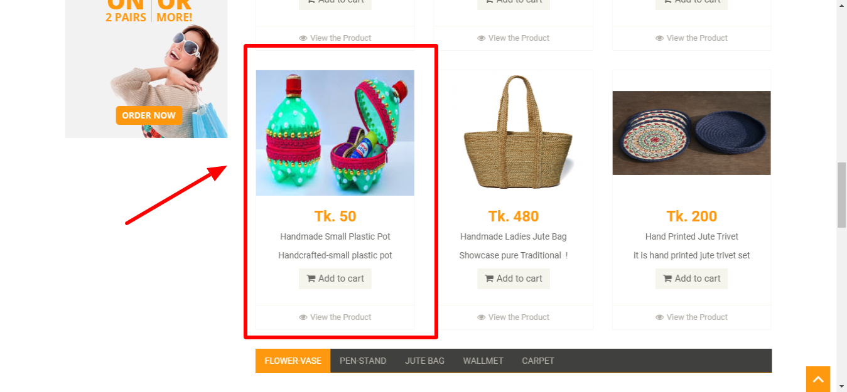
Display Product in Webpage
Flow chart
Figure : Show Product in webpage

Slide 34
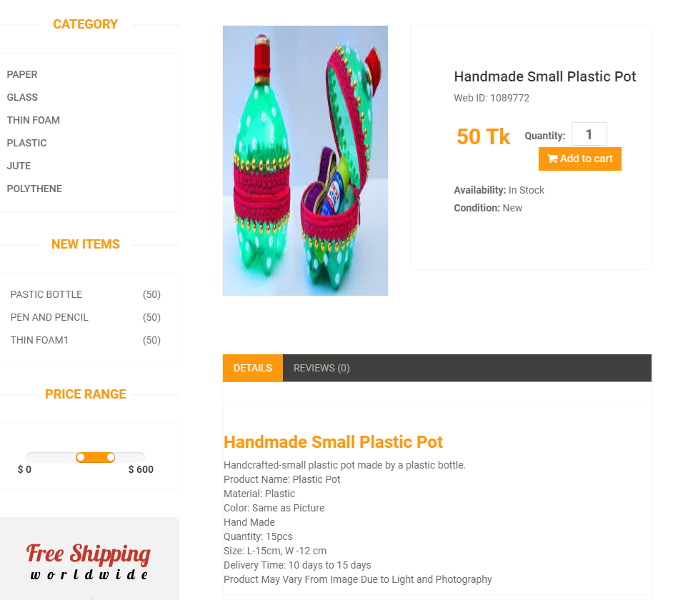
Display Product Details
Flow chart
Figure : Product Details

Slide 35
Update a Product
Flow chart
Figure : Edit Product

Slide 36
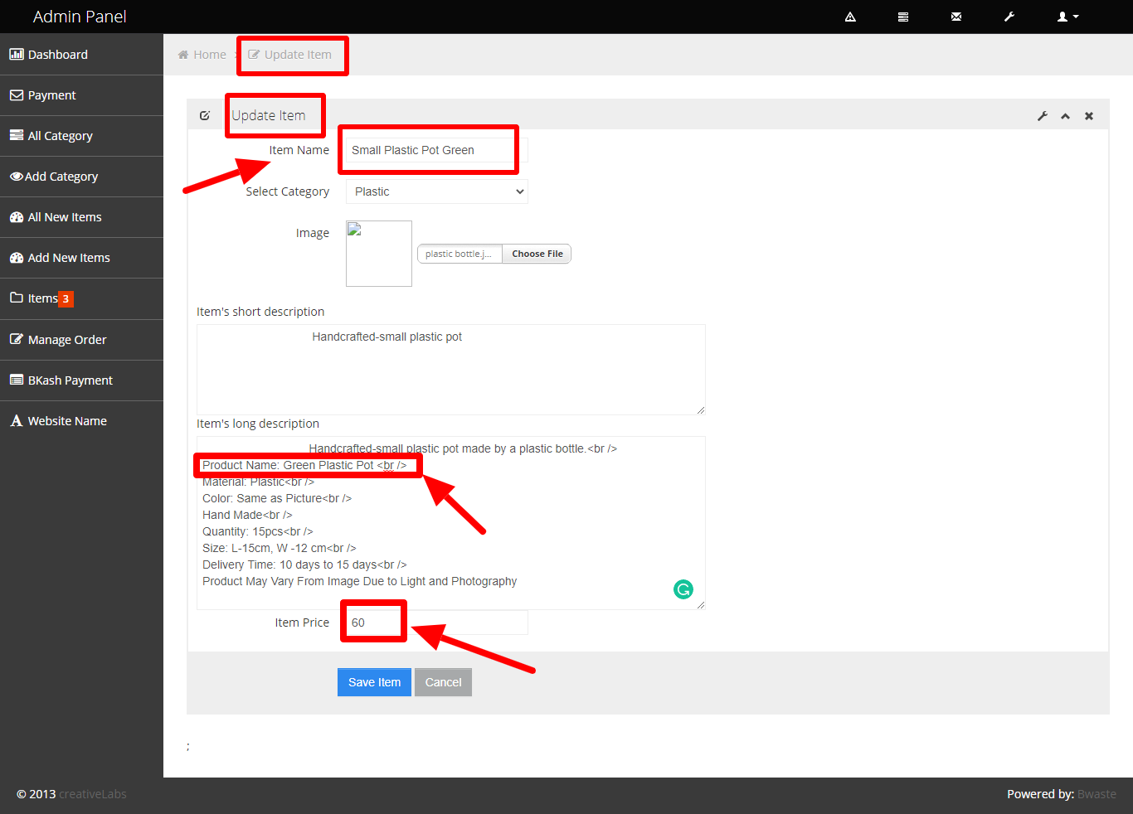
Update a Product
Flow chart
Figure : Edit Product

Slide 37
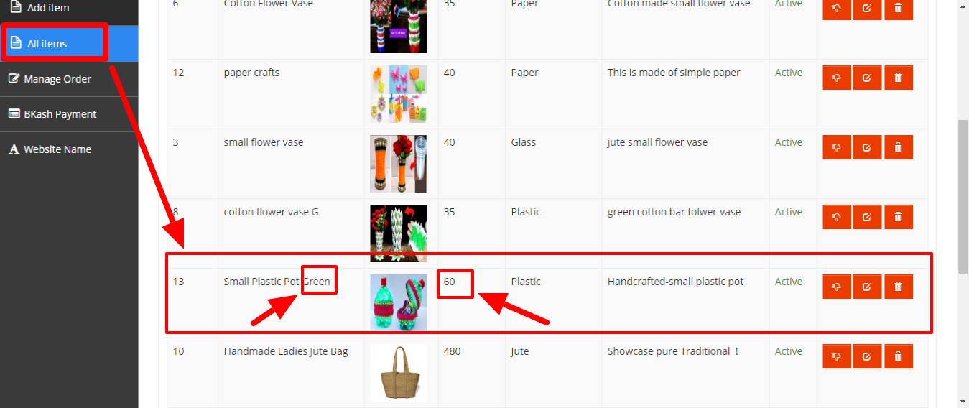
Update a Product (Cont.)
Flow chart
Figure : Edited Product

Slide 38
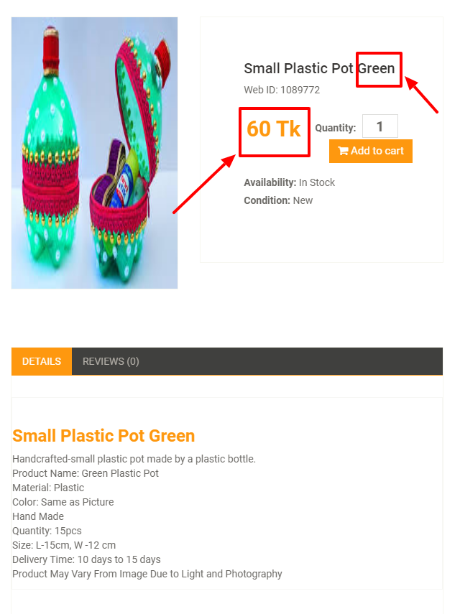
Update a Product (Cont.)
Flow chart
Figure : Edited Product

Slide 39
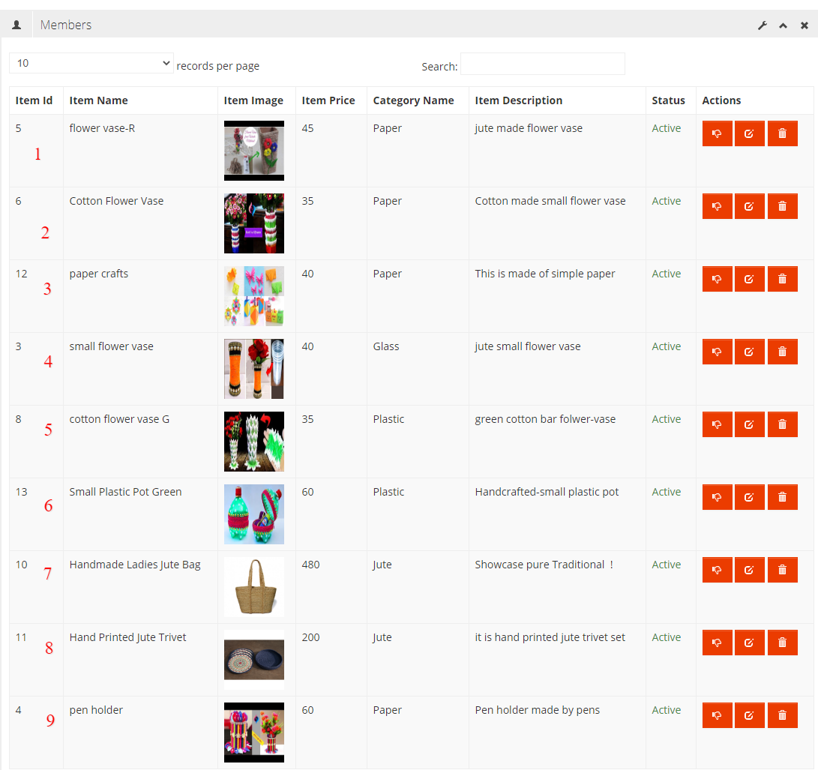
Drop Product
Flow chart
Figure : Drop a Product

Slide 40
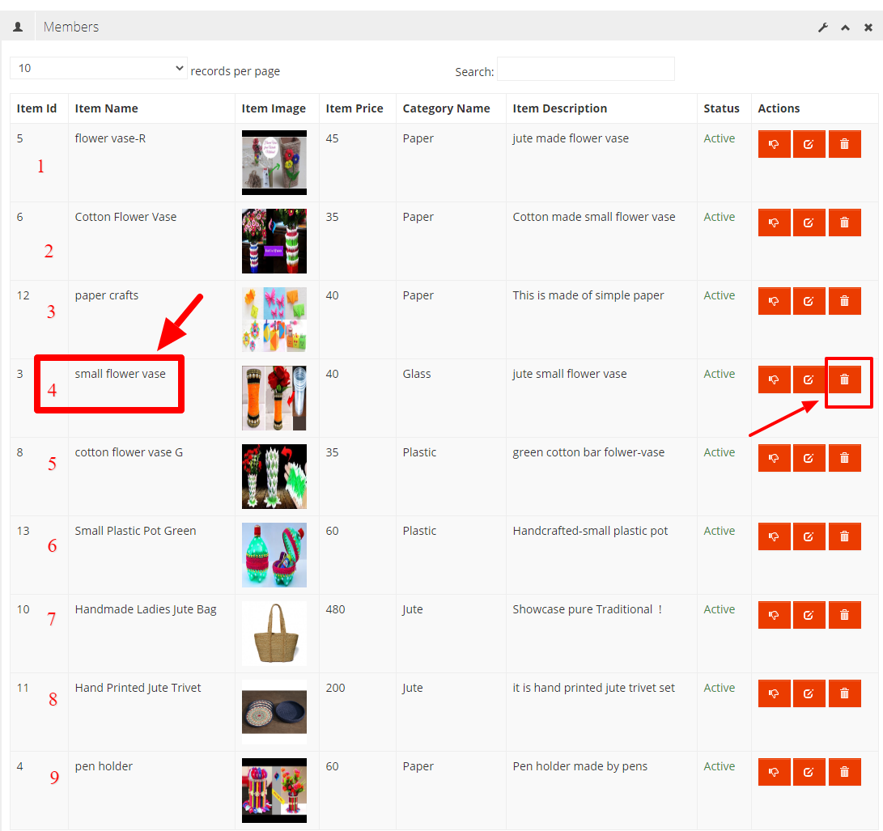
Drop Product (Cont.)
Flow chart
Figure : Drop a Product

Slide 41
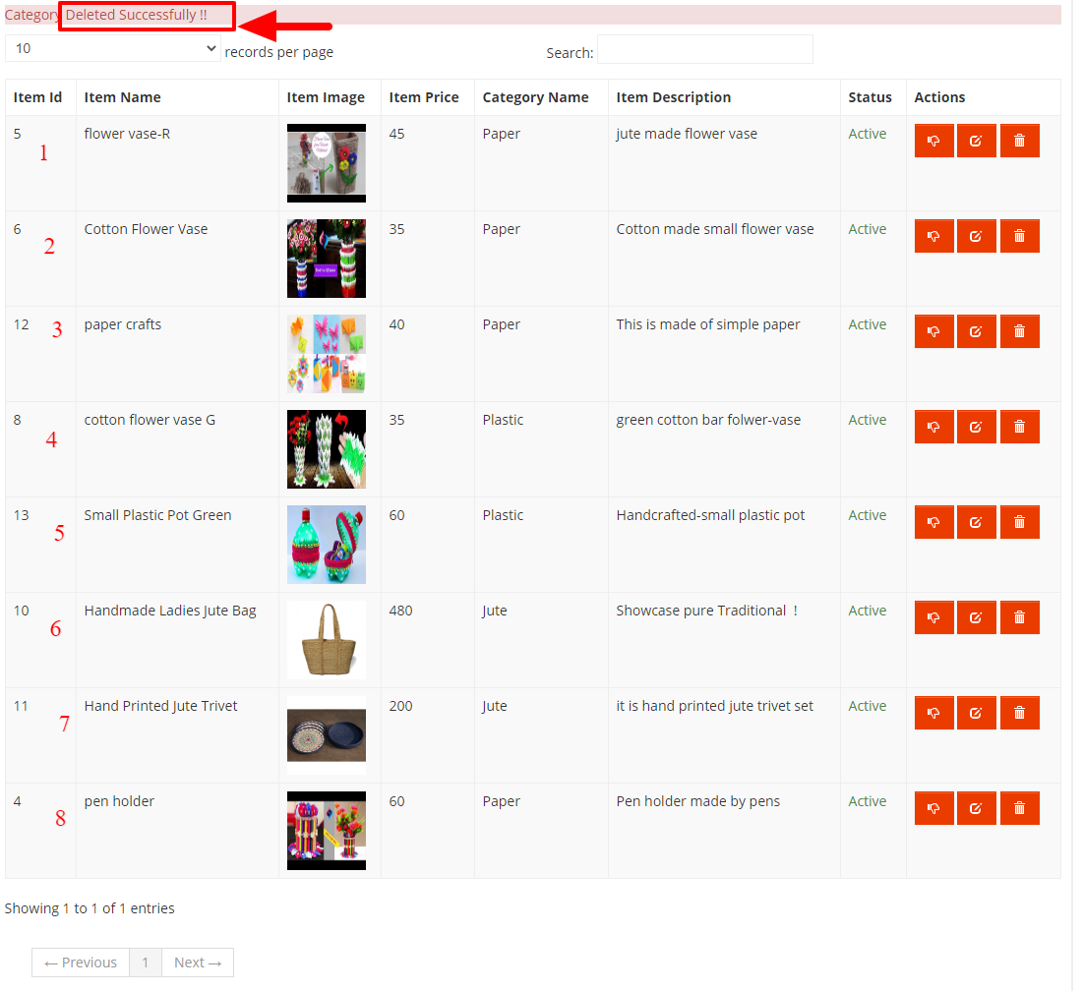
Drop Product (Cont.)
Flow chart
Figure : Dropped Product

Slide 42
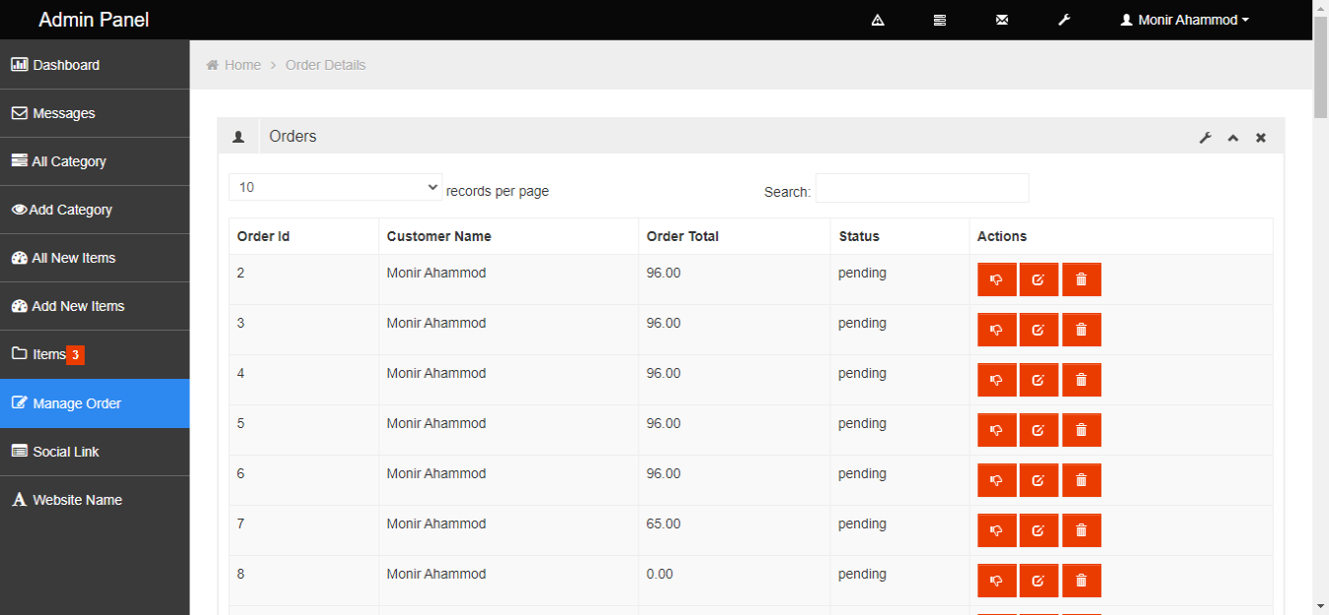
Manage Order
Flow chart
Figure : Manage Order

Slide 43
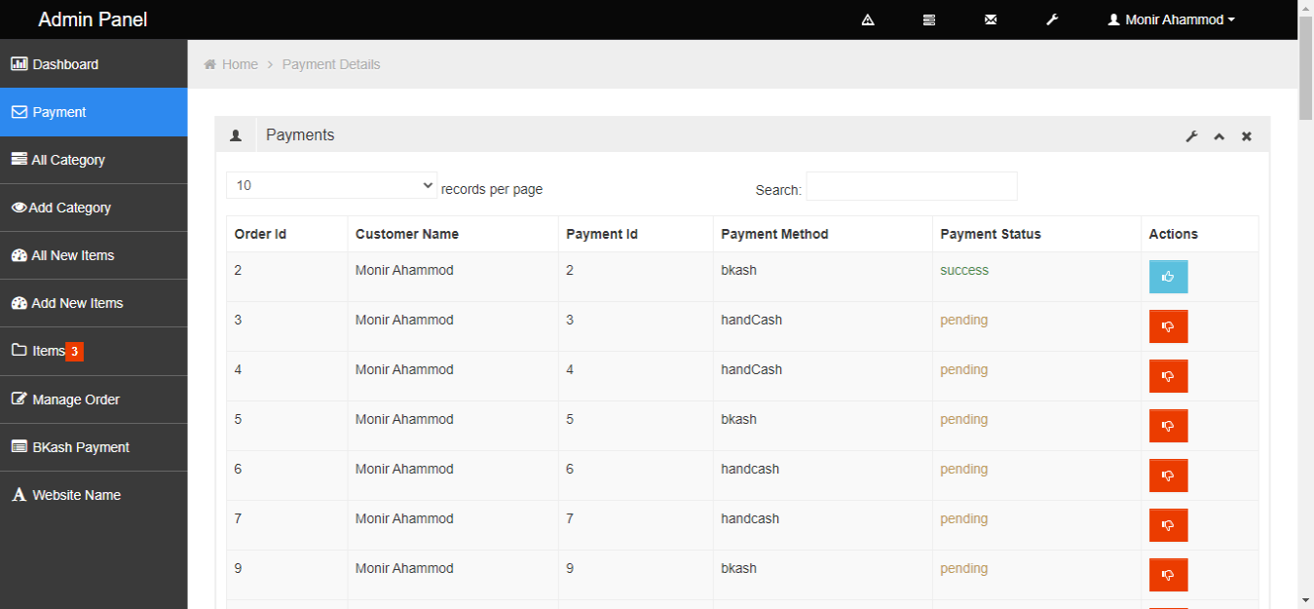
Payment Details
Flow chart
Figure : Payment Details

Slide 44
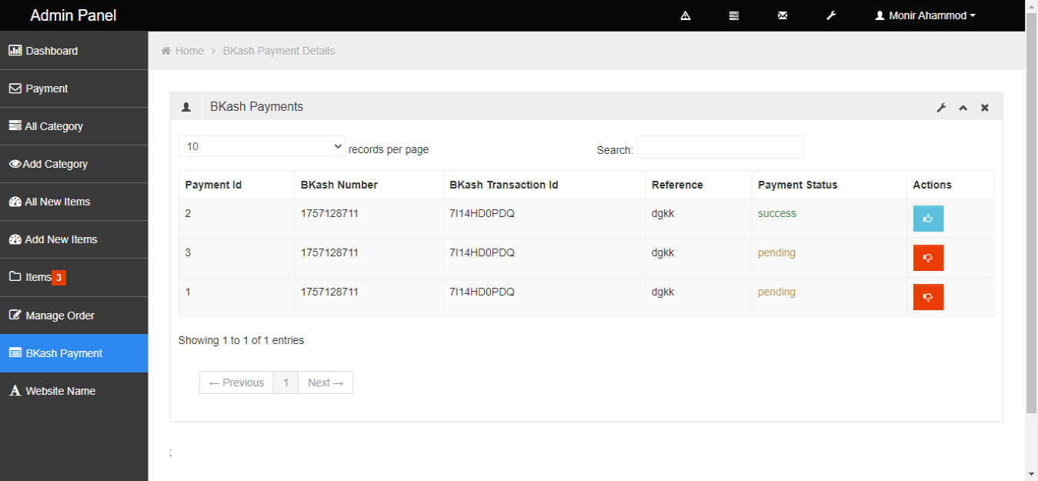
BKash Payment Details
Flow chart
Figure : BKash Payment Details

Slide 45
Conclusion & Future Scopes
This website has taken quite a bit of a long time.
I got to learn a lot of new technologies like ‘Laravel framework’.
This project turns my dream idea into reality.
Higher Authentication can be implemented.
New version 8.x released recently.

Slide 46
Thanks All

